Slide 1

Kongu Engineering college
MICROSERVICES BASED ON CLOUD APPLICATIONS
06.05.2022
Teammates:-
Veenas Kumar S – AI&DS[2021-2025]
Vijayakumaran S - AI&DS[2021-2025]

Slide 2
Content
Introduction
Microservices
Cloud
Implementing Microservices in Cloud
Advantages and Disadvantages in Microservices
To prevent the Security Implementation in Microservices
Result and Conclusion

Slide 3
Era of Microservices
Microservices is an architectural design for building a distributed application using containers.
They get their name because each function of the application operates as an independent service.
This architecture allows for each service to scale or update without disrupting other services in the application.
Before Microservices Era the companies were used Monolithic Method.

Slide 4
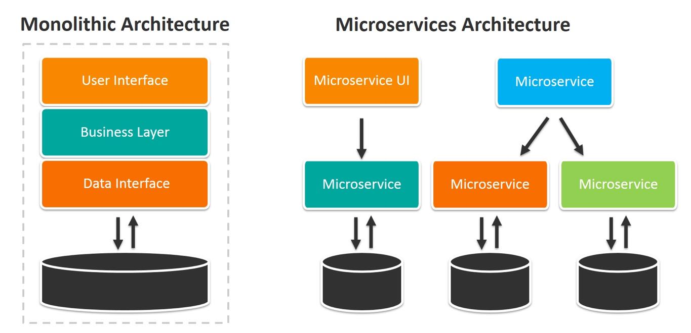
Symbolic Representation

Slide 5
Monolithic vs Microservices
MONOLITHIC ARCHITECTURE | MICROSERVICE ARCHITECTURE
Consists of a single code base with multiple modules within according to the business functionalities | Consists of individual service with each service being responsibilities for exactly one functionality
Do not need expert domain knowledge for developments | Risky to implement without domain expertise and container knowledge.
Easier deployment | Relatively complex deployment
Updating the system is a tedious process which would need the entire system to be redeployed. | Only the service which is updated needs to be redeployed.
Reusing the modules from one software into other software systems is difficult | Microservices can be easily used in development of other software.

Slide 6
CLOUD
"The cloud" refers to servers that are accessed over the Internet, and the software and databases that run on those servers.
Cloud servers are located in data centers all over the world.
By using cloud computing, users and companies do not have to manage physical servers themselves or run software applications on their own machines.
Cloud computing is possible because of a technology called virtualization.

Slide 7
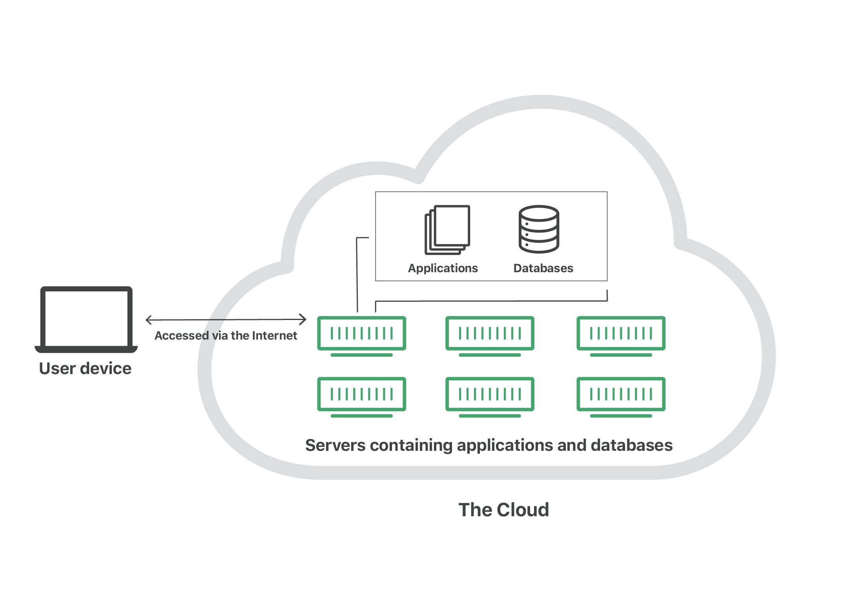

Slide 8
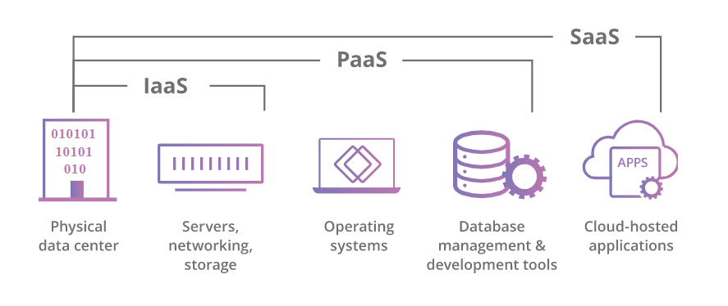
Main service models of Cloud Computing

Slide 9
Infrastructure-as-a-Service (IaaS): In this model, a company rents the servers and storage they need from a cloud provider. They then use that cloud infrastructure to build their applications. IaaS providers include DigitalOcean, Google Compute Engine, and OpenStack.
Platform-as-a-Service (PaaS): In this model, companies don't pay for hosted applications; instead they pay for the things they need to build their own applications. PaaS vendors offer everything necessary for building an application, including development tools, infrastructure, and operating systems, over the Internet. PaaS examples include Heroku and Microsoft Azure.
Software-as-a-Service (SaaS): Instead of users installing an application on their device, SaaS applications are hosted on cloud servers, and users access them over the Internet. Examples of SaaS applications include Salesforce, MailChimp, and Slack.
Function-as-a-Service (FaaS): FaaS, also known as serverless computing, breaks cloud applications down into even smaller components that only run when they are needed.

Slide 10
Different Types of Cloud Deployments
Private Cloud
Public Cloud
Hybrid Cloud
Community Cloud(Multi-Cloud)

Slide 11
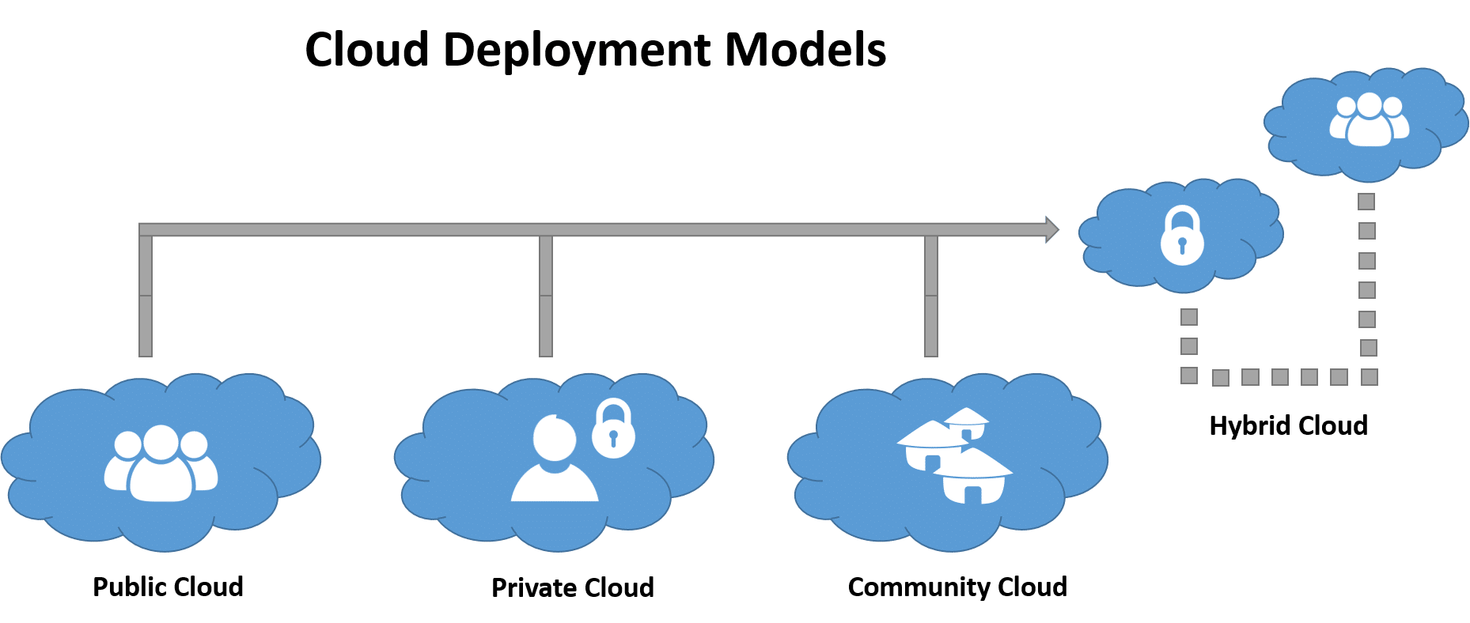

Slide 12
Implementation of Microservices in Cloud
Microservices are an architectural approach to creating cloud applications.
Each application is built as a set of services, and each service runs in its own processes and communicates through APIs.
The evolution that led to cloud microservices architecture began more than 20 years ago.

Slide 13
Advantages of Microservices

Slide 14
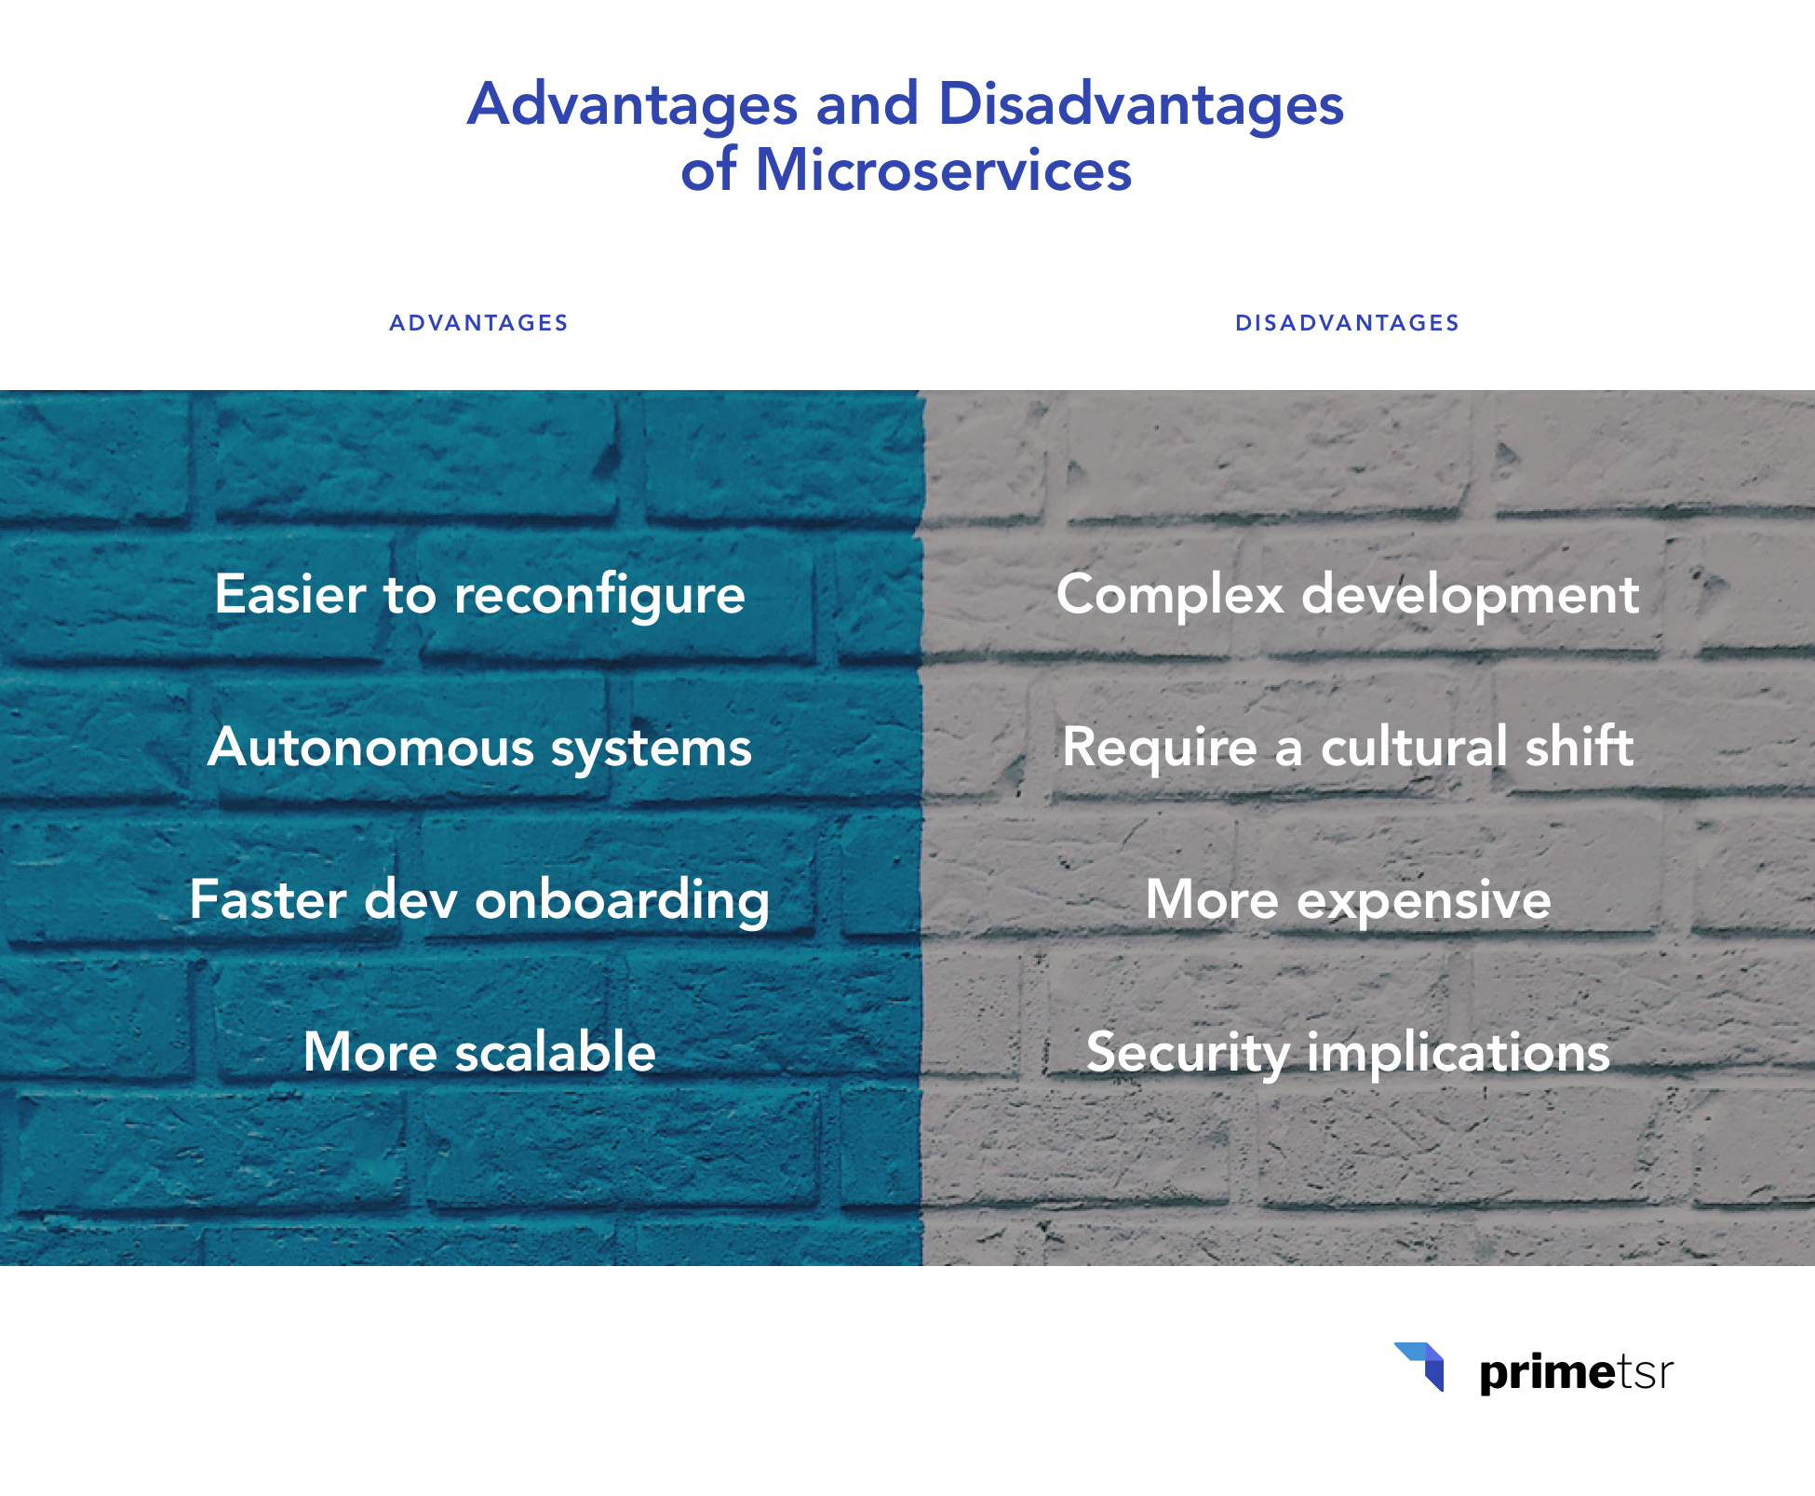

Slide 15
To prevent the Security Implementation in Microservices
Make your microservices architecture secure by design
Scan for dependencies
Use HTTPS everywhere
Use access and identity tokens
Encrypt and protect secrets
Slow down attackers
Know your cloud and cluster security
Cover your security bases

Slide 16
Result and Conclusion

Slide 17
References

Slide 18
Thank You

